Slide 1


HIT, Deep Learning
Project Summary

Slide 2
Table of contents
1
2
Problem Selection
Model Architecture
5
6
7
Training & Evaluation
Analysis
Presentation
3
4
Data Collection
Implementation
Acquirement and Preprocess of the Dataset
IPython Notebook using a Deep-Learning Framework
Real-World Problem
NN Architectural Design
Results Analysis, Challenges, Potential Growth
GitHub Code, Youtube Video
Train, Hyperparameters Tuning, Performance Optimization, Evaluation

Slide 3

Meet our team
Ofir Cohen
Adir Gelkop
***
***

Slide 4
Problem Selection
1

Slide 5

GDP growth rate reflects the health of an economy.
Accurate predictions will assist decision-makers,
businesses, and investors in planning and decision
making.
This project is going to empower better policy decisions,
more informed investments, and improved economic
insights.
----------------------------------------------------------------
Why Deep Learning?
DL helps us in capturing complex, non-linear
relationships between economic indicators.
As we learned, choosing the correct model, can handle
time-series dependencies effectively.

Slide 6
Model Architecture
2

Slide 7

Custom Neural Network for GDP Growth Rate Prediction
Random Forest
GRU
LSTM
Transformers
TCN
WaveNet

Slide 8
Sentence-BERT and GPT-2 for RAG Agent
Semantic Retrieval: Sentence-BERT ensures precise retrieval of relevant economic data.
Efficient and Scalable: FAISS indexing accelerates document retrieval.
Dynamic Responses: GPT-2 generates coherent, context-aware answers.
Optimized Parameters: Hyperparameters like temperature (0.7) ensure balance in creativity and precision.
User Interaction: Gradio enables real-time, interactive exploration.

Slide 9
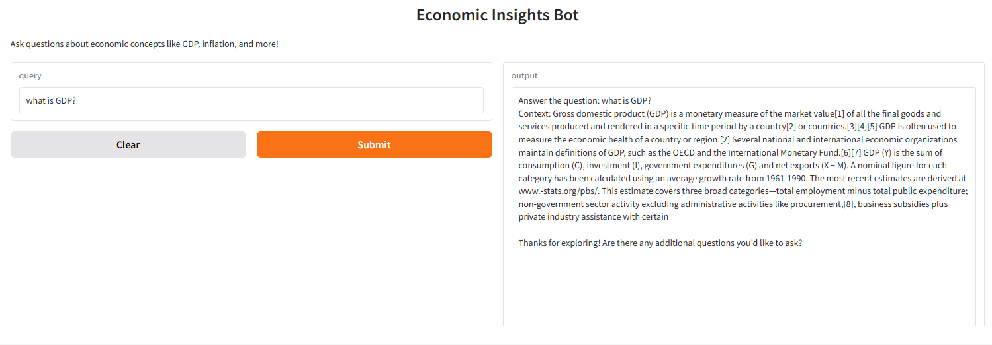
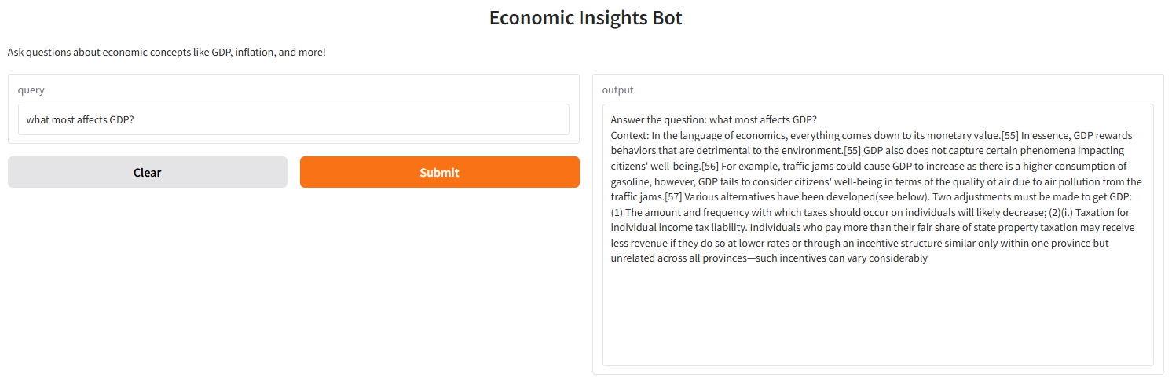
Sentence-BERT and GPT-2 for RAG Agent

Slide 10
GRU
Sequential Modeling: GRU captures temporal dependencies in GDP growth rates.
Efficient Architecture: A single GRU layer (hidden size = 32) balances capacity and simplicity.
Rolling Window: A 12-month input window captures seasonal economic trends.
Optimized Training: Adam optimizer and 100 epochs enable robust convergence.
Scalable Performance: GPU usage ensures efficient computation for iterative updates.

Slide 11
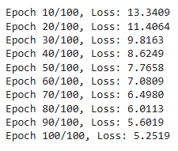


GRU

Slide 12
LSTM
Temporal Modeling: LSTM effectively captures long-term dependencies in sequential GDP data.
Balanced Architecture: A single LSTM layer (hidden size = 32) balances complexity and efficiency.
Rolling Window Input: 12-month input sequences capture seasonal and temporal trends.
Optimized Training: Adam optimizer (LR = 0.001) and MSE loss ensure stable and accurate learning.
Robust Evaluation: Train-test split and metrics like MAPE validate the model's reliability.

Slide 13
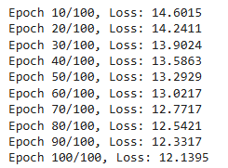


LSTM

Slide 14
Random Forest
Classic ML: RF differs from deep learning by focusing on tabular data and feature-level patterns.
Ensemble Learning: Combines multiple decision trees to improve generalization and reduce overfitting.
Feature Importance: Outputs interpretable insights on how economic indicators affect GDP growth.
Hyperparameter Tuning: GridSearchCV optimizes parameters for robust performance.
Baseline Model: Serves as a comparative benchmark against sequential deep learning methods.

Slide 15

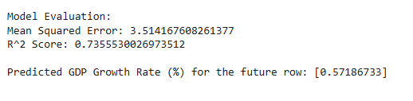
Random Forest

Slide 16
Transformers
Long-Term Dependencies: Transformers process entire sequences, capturing complex patterns effectively.
Self-Attention Mechanism: Dynamically focuses on the most relevant features at each time step.
Efficient Architecture: 4 attention heads, 2 layers, and a hidden size of 64 optimize performance.
Dropout Regularization: Dropout (0.1) prevents overfitting and improves generalization.
Advanced Modeling: Outperforms sequential models (e.g., LSTM, GRU) for multivariate time-series data.

Slide 17
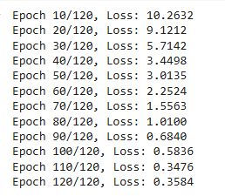


Transformers

Slide 18
TCN
Temporal Pattern Detection: Dilated convolutions capture long-term dependencies in sequential GDP data.
Efficient Processing: TCNs process sequences in parallel, offering faster computation than recurrent models.
Multi-Scale Learning: Dilation rates (1, 2, 4) enable capturing patterns at multiple temporal resolutions.
Regularization: Dropout (0.2) and residual connections prevent overfitting while enhancing stability.
Optimized Training: Adam optimizer and mini-batches ensure efficient and robust parameter learning.

Slide 19
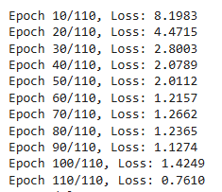


TCN

Slide 20
WaveNet
Casual Convolutions: Captures long-term dependencies efficiently without recurrent structures.
Skip Connections: Improves gradient flow and model stability during training.
Multi-Scale Temporal Modeling: rates ([1, 2, 4, ...]) enable learning across diverse time scales.
Efficient Training: Parallel processing enhances scalability compared to sequential models.
Flexible Architecture: Adapts well to complex, multivariate economic data.

Slide 21
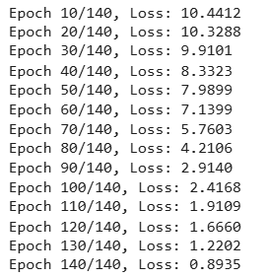


WaveNet

Slide 22
Data Collection
3

Slide 23

Data Preparation Techniques
Preprocessing: Filtered US data and aligned Date for temporal sequence modeling.
Resampling: Standardized data to monthly frequency for consistent input sequences.
Imputation: Applied linear interpolation and fills to ensure data continuity.
Normalization: Rescaled features (e.g., CPI, Treasury Yield) for model-friendly inputs.
Feature Enrichment: Integrated FRED indicators to enhance input dimensionality.

Slide 24
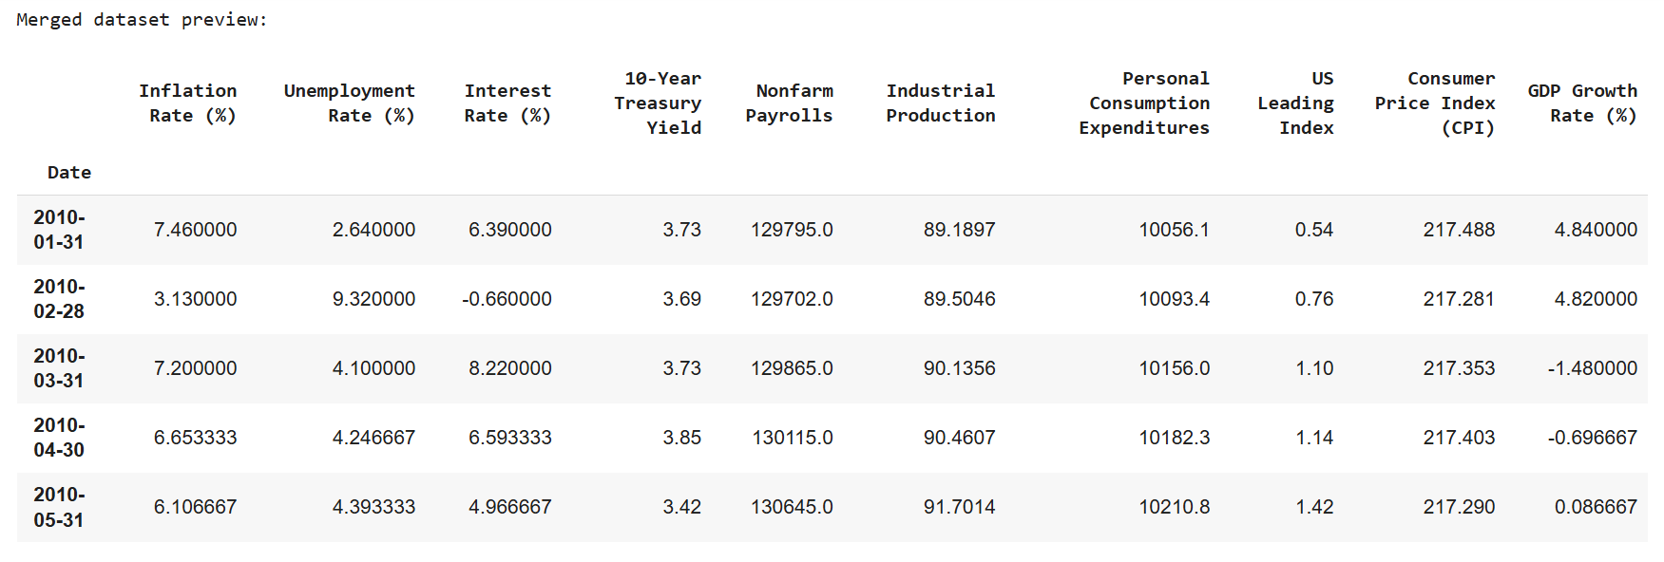
Solution
Neptune is the farthest planet from the Sun. It's also the fourth-largest by diameter in the Solar System

Slide 25
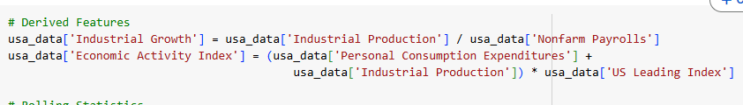
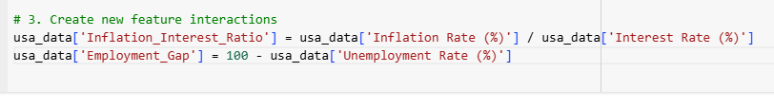

Slide 26
Implementation
4

Slide 27
Training & Evaluation
5

Slide 28
Analysis
6

Slide 29
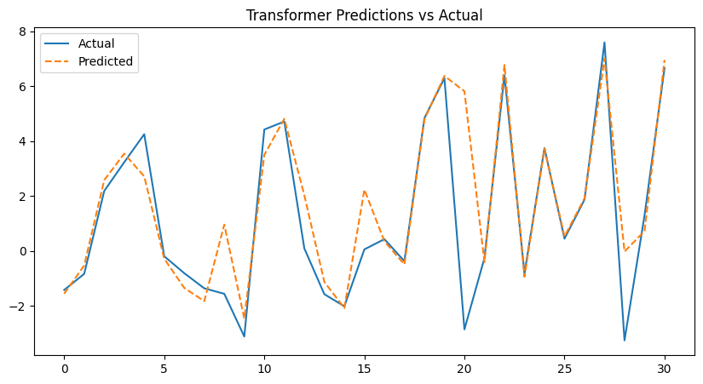
Transformers
Evaluation
The Transformer model's predictions closely follow the actual GDP growth rate trends, reflecting strong alignment with observed data.
The prediction for the next period indicates moderate economic growth, suggesting stability with a cautious optimism about future performance.
Predicted GDP Growth Rate for the next period: 0.7282%

Slide 30
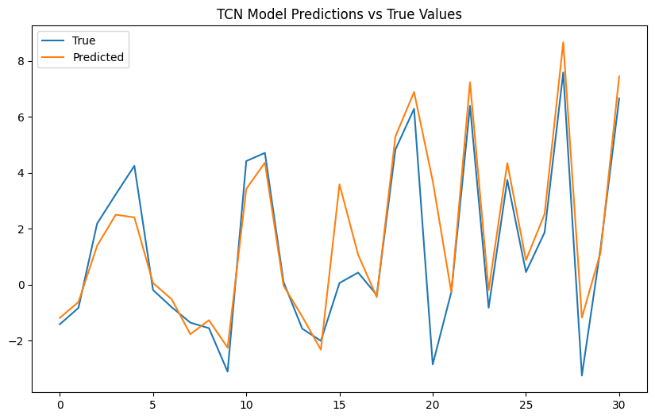
TCN
Evaluation
The TCN model shows strong predictive accuracy, closely mirroring the true GDP growth rate fluctuations.
The next-period forecast indicates stronger economic growth, pointing to potential investment and financial planning opportunities.
Predicted GDP Growth Rate for the next period: 1.2485%

Slide 31
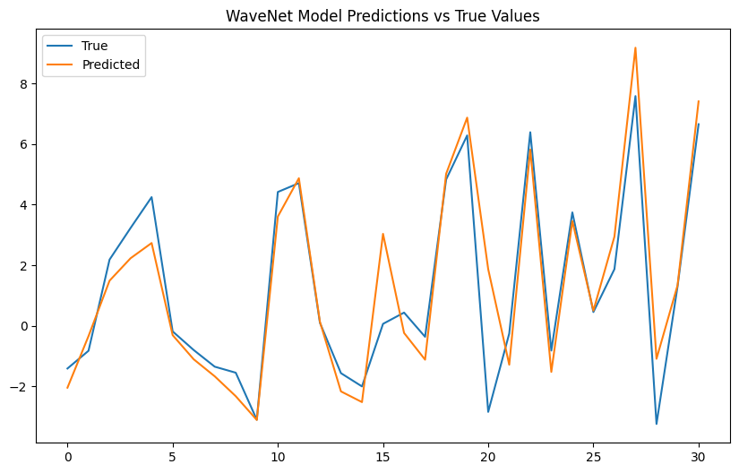
WaveNet
Evaluation
The WaveNet model effectively tracks GDP trends with close alignment to actual values. The next-period prediction suggests modest economic growth, reflecting a more cautious outlook for short-term performance.
Predicted GDP Growth Rate for the next period:
0.3866%

Slide 32
Presentation
7

Slide 33

GitHub Repo Link
https://github.com/AdirGelkop/Deep_Learning_USA_GDP_Project/blob/main/Final_DL_GDP_Prediction.ipynb

